Slide 1
Unit Elections
2025
Jacob Smith
2025-2026 Tipisa Induction Chairman
Answers to questions: Inductions@tipisa.org

Slide 2
Unit Election Basics
Chiefs and Advisers are…
  Leaders and expected to be knowledgeable.
    (Why you’re here at LLDC!)
  Responsible to ensure that all election teams are properly trained and prepared.
    (Why you’re here in this class!)
Things change…plan ahead.

Slide 3
Unit Elections
Lodge Resources
LLD Training
Tipisa LEC Notebook
TIPISA.ORG/resources/inductions
  Unit Election
  Ordeal
  Journey to Brotherhood
Lodge Leaders!
  Officers & Advisers – All
  inductions@tipisa.org

Slide 4
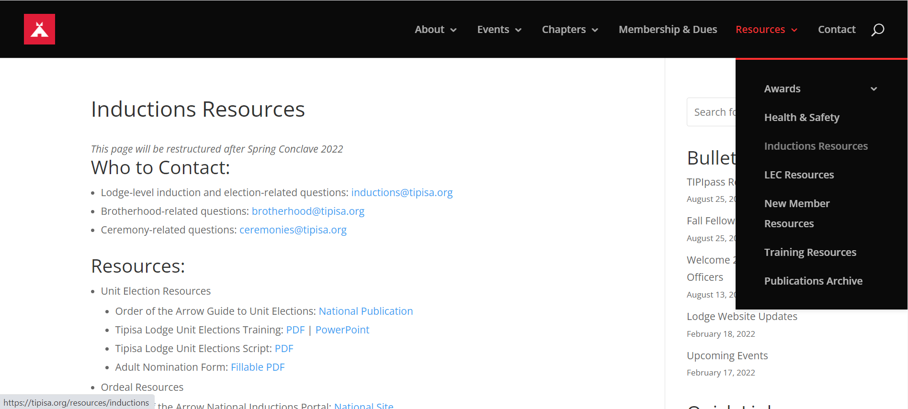
Unit Elections tipisa.org/resources/inductions

Slide 5
Unit Elections
National Resources
OA-SCOUTING.ORG/resources/inductions
  Publications
  Ceremony Resources
  Polestar
  Video and Participant Workbook: Chapter 3 – Unit Elections
OA-SCOUTING.ORG/resources/publications
  The Guide to Unit Elections (GTUE-202206.pdf)
    Detailed training and guidance
  Handbook for Officers and Advisers (HOA-202306.pdf)
    Official Policy (Adult ratios – Pg 19)

Slide 6
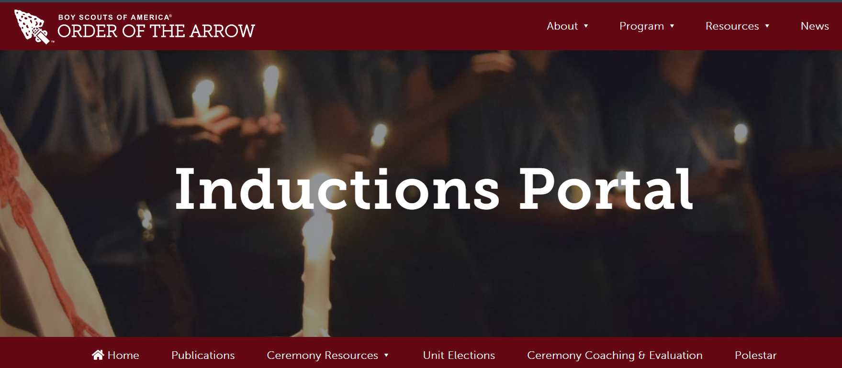
Unit Elections oa-scouting.org/resources/inductions

Slide 7
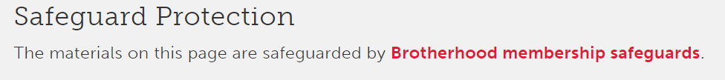
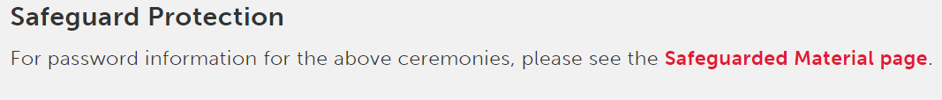
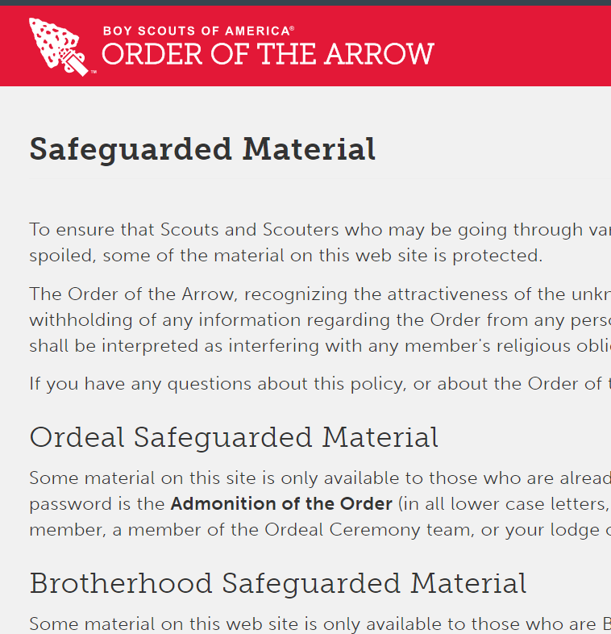
Unit Elections
National Resources

Slide 8
Unit Leader and
OA Election Team
“Rights” and “Responsibilities”

Slide 9
Unit Leader Rights
May permit or deny an OA election
  Chapter Leaders: Record and report all denied elections to the Inductions Chairman (inductions@tipisa.org)
May introduce and describe what the OA is before the team presents.
  If the Unit Leader is not a member, ask to consult with them.
  First impressions are everything.
May count votes with the election team privately
  Best Practice: Invite the Unit Leader to count with the team
May determine when candidates are publicly recognized
  Best Practice: Recognize Candidates using the Unit Elections Script
  Tipisa.org/resources/inductions

Slide 10
Unit Leader Responsibilities
Certify youth eligibility before the election
  Rank (or higher)
    Scouts BSA – First Class
    Sea Scouts – Ordinary
    Venturing – Discovery Award
  Camping Requirement
    15 Days & Nights –Under the auspices of BSA
    (Including, but not more than, 5 Long-term nights)
    (Polestar: Camping “…gives Scouts the time to witness each other’s actions, during good days and bad.”)
    Ship nights may be counted as camping for Sea Scouts
    (GTUE, Page 13, FAQ 4)
      It is preferred that camping requirements be met as part of the unit in which the youth is being considered for election.
      Extenuating circumstances may exist (e.g., in case where a youth did not have an opportunity to meet the requirement with the unit), that make it appropriate for unit leaders to consider other BSA camping experiences (e.g. a Venturer counting camping nights completed with a troop or camping nights completed while serving as a staff member at a council camp or national high adventure base).
      In each case, the unit leader must satisfy themselves the spirit and intent of the requirement was met (i.e., it was indeed qualifying outdoor camping).
  Scout Spirit

Slide 11
Unit Leader Responsibilities
Ensure that the name and rank of each eligible youth is accurate and correctly spelled on the Unit Election Report.
  The team may print while the UL dictates
  All data must be recorded for elected scouts, but only name and rank are required on the form before the UL signs.
Ensure that the date and attendance criteria are completed (and valid) before the UL signs.
  # Registered Active
  # Attending (must be at least 50% of Registered Active)
When all the above criteria have been recorded, the UL signs the Unit Election Report
  The election officially begins when the Unit Election Report is signed by the Unit Leader.
  No name may be added or removed after the Unit Leader signs the Unit Election Report.

Slide 12
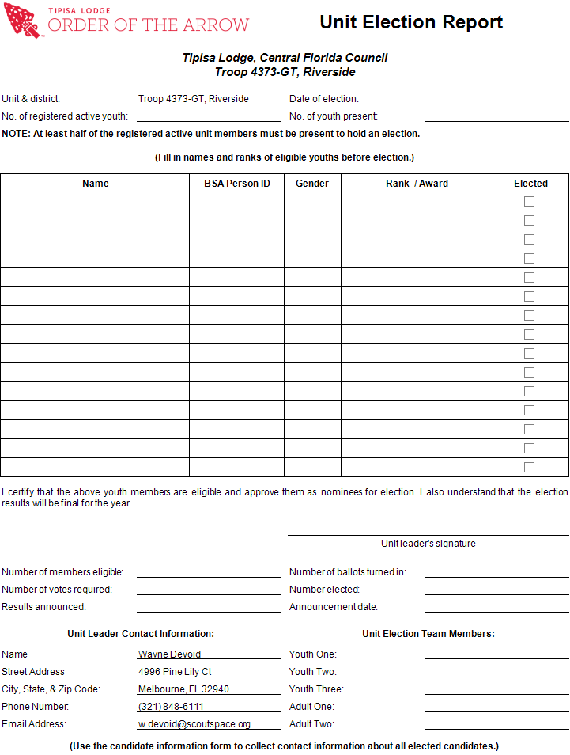

Slide 13
The Election Team May Not…
Conduct the election until the Unit Election Report is signed by the Unit Leader.

Slide 14
The Unit Leader May Not…
Change the eligibility list after the election has begun
Change the outcome of the election
Prohibit a 2nd round if none are elected on the 1st

Slide 15
Youth Eligibility
1. Be a registered member of the Scouting America.
2. At the time of their election, youth must
  be under the age of 21,
  hold the Scouting America First Class rank, the Venturing Discovery Award, or the Sea Scout Ordinary rank or higher, and
  following approval by the Unit Leader, be elected by the youth members of their unit.
3. Within the two years immediately prior to the election, the youth must have experienced
  15 nights of camping while registered with a troop, crew or ship.
    The 15 nights must include one, but no more than one, long-term camp consisting of at least five consecutive nights of overnight camping, approved and under the auspices and standards of the Scouting America.
    Only five nights of the long-term camp may be credited toward the 15-night camping requirement;
    the balance of the camping (10 nights) must be overnight, weekend, or other short-term camps of, at most, three nights each.

Slide 16
Youth Eligibility cont.
4. Assistant scoutmasters who are 18, 19 or 20 years old are also considered to be youth members for the purpose of OA elections. All requirements shown above must be met for a young assistant scoutmaster to be eligible for election.
Prior to the annual election, the unit leader must certify the nominee’s Scout spirit and youth membership qualifications.
Voting for youth candidates will be based on their spirit of brotherhood, cheerfulness (no matter how tiresome their duties), and a willingness to give unselfish and wholehearted service to others at all times.

Slide 17
Adults
Nominated Recommended Approved
“Nominated” (not “elected”) by Unit Committee
  IF elected-youth = 0, THEN adults nominated = 0
  IF at least 1 youth is elected, THEN
    Multiply # elected by 2/3 (.66) and round up to the nearest whole number.
    LodgeMaster will auto-calculate and email UL & Cmte Chair
  IF the Unit Leader has held the position for at least the previous 12 months AND is not an OA member THEN
    The Unit Committee MAY ALSO nominate the Unit Leader
      NOT Assistant Unit Leaders
      This is in addition to any “2/3” nominations
“Recommended” by Adult Selection Committee
  Lodge Adviser & Staff Adviser
  Council Camping Committee Chairman
“Approved” by Scout Executive

Slide 18
Adult Eligibility
Same camping requirement as a youth
  No exceptions or waivers
  Cub Scout camping doesn’t count
Nominated by Unit Committee
  NOT an honorarium, recognition, or “Thanks, bud!”
  ONLY if at least one youth is elected
  ONLY to contribute to the OA’s program
  Requires a completed OA Adult Nomination Form
    LodgeMaster will email Unit Leader and Cmte Chair AFTER youth election results have been “Posted” by the chapter and “Approved” by the lodge.

Slide 19
District or Council Adults
May be nominated only if the Adult’s primary registration is the District or Council by:
  Lodge Adviser, District Chairman
  Council President, Professional Staff (Paid)
May have the camping requirement waived
Professionals are ex officio members (“from the office”) of the lodge while they are employed.

Slide 20
Adult Nominations
Should provide enough detail to
  Convey why and how the nominee is particularly suited to mentoring scouts so as to instill the values of the Oath and Law.
  Give examples of the nominee’s interactions with scouts and/or why the nominee can be relied on to fulfill aspects 2, 3, or 4 of the Order’s purpose.
While the OA is not an honor or recognition for adults, the nomination should be robust enough that it could be read at an awards ceremony.
The objective is to give the review committee confidence in the nominee’s suitability.

Slide 21
Adult Nominations
Require a statement of
  Individual Abilities
  Fulfilling the OA’s Purpose
  Positive Role Model
Providing these statements can be challenging for those who are unfamiliar with the OA.
To assist unit leaders, an Adult Nomination Guide is included in the adviser LEC notebooks.

Slide 22
The Adult Nomination Guide
The Adult Nomination Guide clearly explains
  The OA’s role in fulfilling the Scout Mission
  The OA’s role in supporting the unit program
  The adult role in the OA
Provide a copy to
  Unit Leaders and/or Committee Chairs
  Any Scouter or parent curious about the OA’s role in Scouting and/or the adult role in the OA.

Slide 23
Election Planning
Coordinate with the UL for time and place for the OA election.
  Meeting, campout, event… Fine!
  LodgeMaster will send the initial email to Unit Leaders
    The chapter must follow up to verify they received it
    Best Practice: Use the lodge standard follow up letter
Show up as promised!
  The Order must be represented by a trained 2 or 3 member team…
  Youth is team leader. Adult is “support.”
  Best practices:
    Election team members should not conduct voting or count ballots for their own unit. The integrity of the election is enhanced when the team conducting voting is obviously impartial.
    A trained team-member, who is skilled in explaining the Order, it’s purpose, eligibility, and or election procedures, may provide this service to their own unit.

Slide 24
Election Procedure
Eligibility rules must be explained to the troop
At least 50% of the registered active members must be present
  Must hold BSA membership card and participate in some troop activities to be deemed “active”
Both members and non-members can vote
Scouts of the unit considered youth in the OA may likewise vote in an OA election
  A Scout with disabilities, who is classified as a youth member of the unit, shall be considered a youth (voting) member of the Order of the Arrow regardless of age.
  This is the only instance where someone over 21 can vote in an OA election.
Elections conducted outside of a unit’s home council are not permitted. Ever.

Slide 25
Team Leader
Explain to the UL that current procedures will be used
  Available for reference in the UE Notebook
  Brief & Review
    Rights, attendance requirements, and voting rules
Verify that 50% of the registered active members are present
IF the unit does not meet the attendance requirement THEN
  Politely explain that the election cannot be conducted because the attendance requirement has not been met.
  Ask to reschedule the election.
  Excuse the team.

Slide 26
Election Team
Full uniform & sash
“A Scout is Clean”
Use the Unit Election Script
  Tipisa.org/resources/inductions
Use paper ballots with candidate names
  Ballots will be sealed & retained by the chapter for 1 year following election
    The UE envelope can be used for this purpose.
    Caution: Forms returned to the Lodge must be kept separate!
    OA election results are rarely challenged.
    Hard-copy proof is indispensable when challenges happen.

Slide 27
Voting
All unit youth members may vote
Scouts may vote for none, one, some, or all candidates
Candidates may vote for themselves
Voting is not required
  “No ballot – No problem”
  Scouts not wishing to vote should fold the ballot, slip it in their pocket, and dispose of it later.
Returning a blank ballot means “I don’t think anyone is worthy for this honor.”
Blank ballots count as a vote against ALL names.

Slide 28
Electing
Election requires 50% approval from ballots received
  Even/2 or (Odd + 1)/2
If none are elected in the 1st round
  Explain the OA once again and the desire we have to recognize honor campers
  Explain the voting procedures again
If none are selected on 2nd round
  No more rounds – done until next year
  Thank the unit for their courtesy and time

Slide 29
Post Election Duties
The election is “certified” only when the UE team signs the Unit Election Report.
  DO NOT sign the report until the election is complete!
    Election result for each name properly recorded on the Unit Election Report and verified as correct by both UL and Election Team.
    Ballots counted & sealed.
Conduct: Candidate Recognition Ceremony
Provide Unit Leader with
  Photo of certified Unit Election Report
  “Ordealship” briefing
    Finance is never a barrier!
  Chapter Callout date & location (optional)

Slide 30
Brief Unit Leader on Candidate Status
After election, a candidate is a candidate until the completion of the Ordeal and the Ordeal ceremony.
The Ordeal and Ordeal ceremony must be completed within 18 months of the election date, otherwise…
  https://oa-scouting.org/about/membership
The scout must be reelected to regain candidate status.
The LEC may extend the 18-month limit for illness or other unusual circumstance.

Slide 31
More Post Election Duties
Ensure all data is legible.
Immediately photograph completed UE Report and accompanying candidate information forms & email to inductions@tipisa.org
Chapter may coordinate to enter data into LodgeMaster but the completed UE Reports must still be emailed.
  Candidate information must be completed by the chapter immediately following the election when the results are “Posted” in LM.
  Candidate information submitted using the Excel form MUST (may only) be uploaded by the lodge.
  Best Practice: Do not leave the election without having obtained all of the elected candidate’s information.
Retain UE Report and ballots for one year.

Slide 32
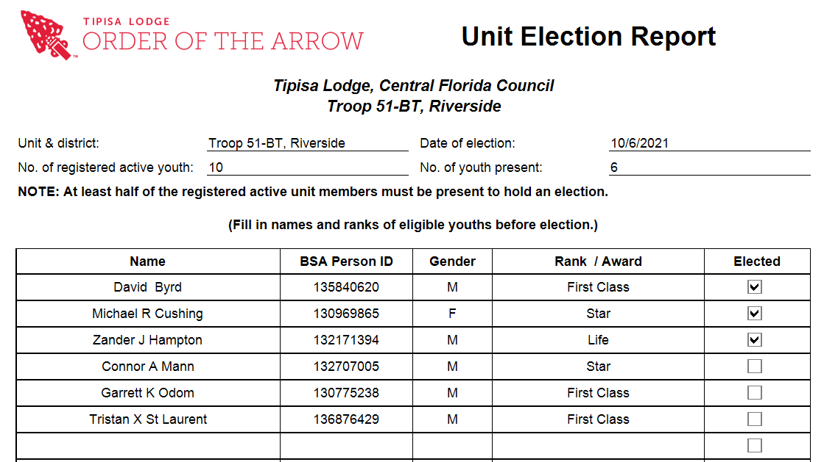
Post Election: email this…

Slide 33
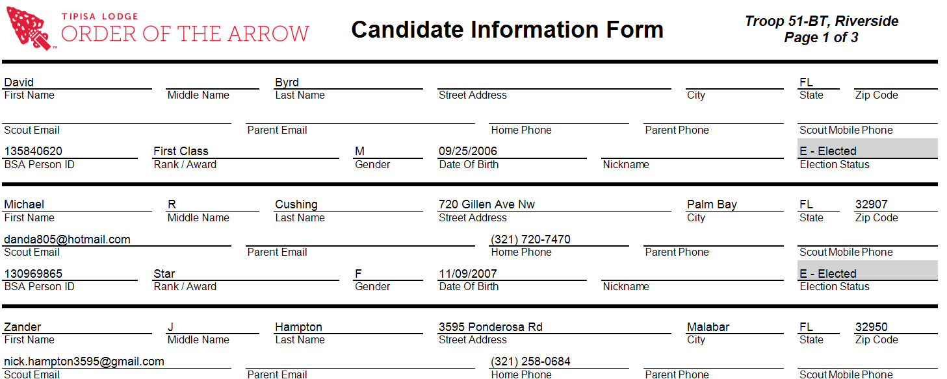
…and these
To: inductions@tipisa.org

Slide 34
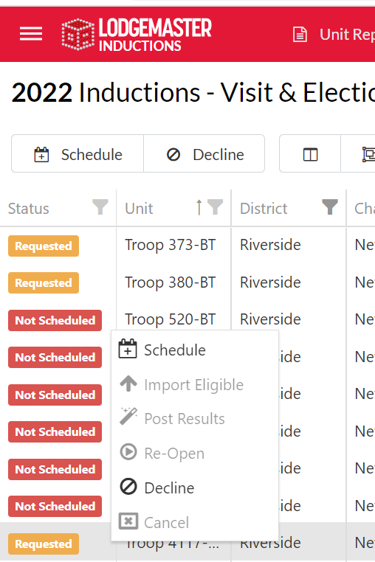
Then “Post” the Election Report and Candidate Info to LodgeMaster

Slide 35
Pop Quiz!
Who is missing must-have information and why is that bad?

Slide 36
(Answer)
David Byrd has no email address.
He will not receive any email communication!

Slide 37
Resources
LEC Notebook
tipisa.org/resources/inductions
oa-scouting.org/resources/inductions
oa-scouting.org/resources/publications
  Unit Elections Handbook
  Handbook for Officers and Advisers
(email) Inductions@tipisa.org

